Slide 1



The Institute for Continuous Improvement in Public Services
2025 ICIPS Maturity Assessment Insight

Slide 2

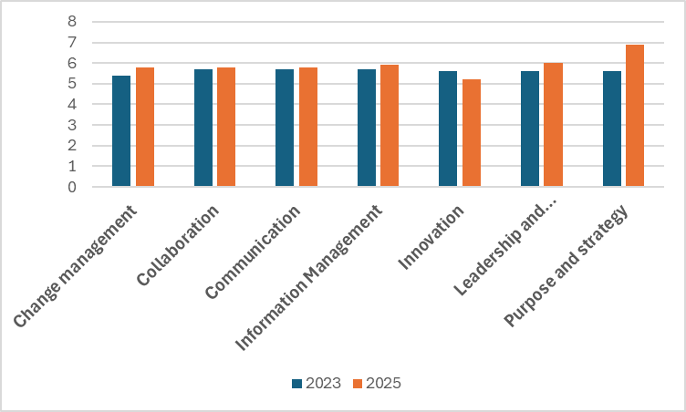



Maturity assessment results
Mean score across all enablers
We’re excited to share the latest insights from our Maturity Assessment, comparing results from 2023 to 2025.
This assessment explores key enablers of Continuous Improvement (CI), combining data and member feedback to create a clear picture of how the embedding of CI is progressing.
Participants rate their agreement with 32 questions, on a scale from 0 – 7. Individual question responses, comment and questions grouped by theme are all made available, to help organisation shape focused improvement plans that drive meaningful improvements. Year-on-year scores help to monitor progress.
ICIPS shares the collective insight with our Members and use the results to inform the Institute’s priorities; ensuring our activities continue to support evolving needs.
Increased scores in most areas indicates progress is being made in embedding CI.
Scores for leadership and management and change management saw the greatest increase in score.
The area of innovation was the one area where scores declined between 2023 and 2025. Early surveys were undertaken during the post covid era, when innovation was at the forefront; it may be that as organisations have returned to steady state; the focus on innovation has dwindled; during the course of 2025 and 2026, ICIPS will undertake research to test this hypothesis.

Slide 3
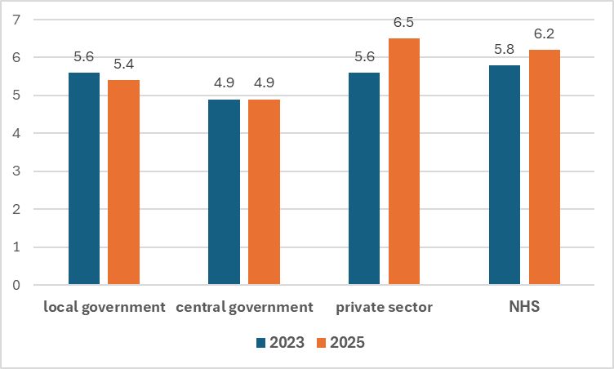
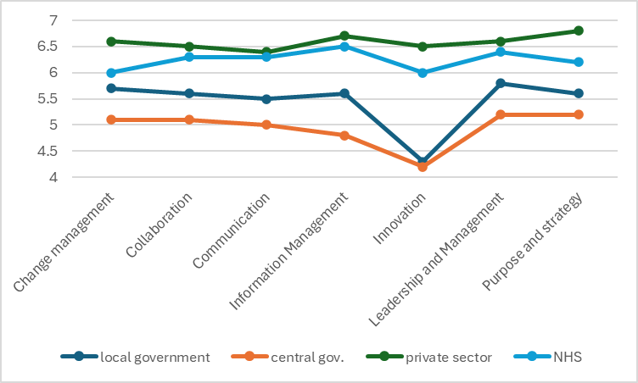
2023 – 2025 results by sector
2025 results by key enabler and sector
Not all maturity assessment participants have repeated the assessment, but from those that did, we can see some interesting insight start to develop.
Results show progress in embedding CI in central government has made little progress, local government shows marginal progress, but the NHS and private sector, showed significant progress.
ICIPS will seek to understand what underlying factors may be causing the results and the differences between sectors.
Results show that in most areas, scores for the NHS and private sector are similar; the exceptions being innovation and purpose; where the private sector scores higher.
Innovation in local and central government also scored far lower than other categories.

Slide 4
Lowest and highest scoring statements
Greatest spread of score
Two statements showed a greater spread of answers than others, ranging evenly from 0 to 7.
‘ The outcomes of change initiatives are communicated across the organisation, so others can learn from failure ands success’
From engagement with Members, ICIPS has identified that organisations who succeed in embedding CI, tend to have good communications systems , which they use to promote CI and organisational learning. It is therefore a concern that if communication are deemed to be lacking, as indicated by the comments.
2) ‘Experienced change professionals are available to support me if required’
We know from ICIPS 2-minute surveys that availability of change professionals is an issue; many organisations have small change teams who rely on training up change champions to lead localised change but don’t always have the time to mentor the champions to a good level of competence.
LOWEST SCORE
The statement which received the lowest score in every survey was ‘’I am given time to explore opportunities to improve the effectiveness and efficiency of the processes I deliver.’ The average score was 5.2, with many comments highlighting the frustrations and challenges around having time to identify and deliver improvements.
HIGHEST SCORE
The highest score of 6.4 was for the statement ‘I understand the purpose of our organisation and the beneficiaries of our services’ . Surprisingly however, 39% scored this 6 and under.

Slide 5
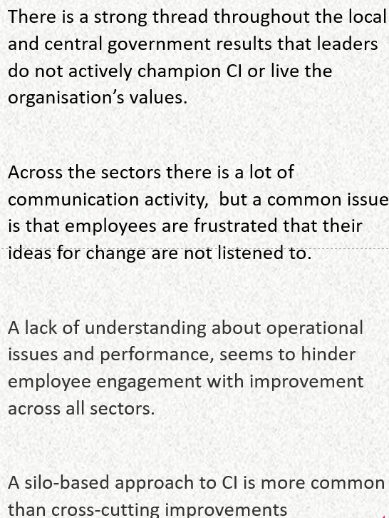
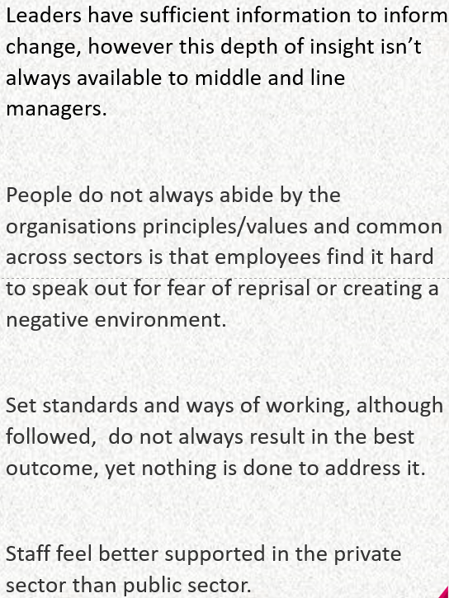
Common themes from employee comments

Slide 6
Continuous improvement
A perfect maturity assessment score of 7 is hard to achieve. Whilst it is easy to implement quick wins, it is often the final % that is the hardest to achieve.
ICIPS 2026 conference will invite leading experts to discuss how to move past quick wins, to innovation and disruptive change, delivering substantial improvements , underpinned with a culture of CI.
In undertaking a CI maturity assessment, your organisation gains invaluable insight and benchmarking data.
With all participant scores amalgamated, every survey contributes to providing insight to informs ICIPS areas of interest and from which all ICIPS members ultimately benefit from.
The assessment if FREE so sign up today and start your journey
Free setup support is available by contacting info@icips.org
www.icips.org
07906 623432

Slide 7


